Slide 1

CAP 6317/4773: Social Media Mining
Lecture 20: Behavior and Information Diffusion
Raiyan Abdul Baten, Ph.D.
April 2, 2024

Slide 2
Recap

Slide 3




Modularity

Slide 4

Modularity
Q_{normalized} is called the Assortativity Coefficient and goes from -1 to 1
If ‘similar’ people have more edges between them than random chance: 0 < Q_{normalized} ≤ 1
If ‘dissimilar’ people have more edges between them than random chance: -1 ≤ Q_{normalized} < 0

Slide 5
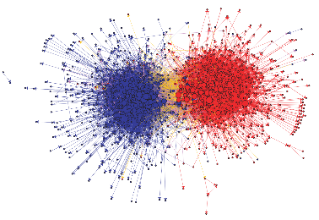
Community Detection using Modularity: Spectral Modularity Maximization
Intuition: If we know the ‘types’ of the nodes, we can calculate Q. If there is assortativity, Q is positive.
Q = (edges inside the community) ­‐ (expected number of edges inside the community due to random chance) > 0
But graph clustering is unsupervised: we do not know the ‘types’ of the nodes ahead of time.
Let us flip the problem: try assigning ‘types’ to nodes, and find the assignments that maximize Q. Voila, those assigned types will be the cluster/community labels!

Slide 6


Community Detection using Modularity: Spectral Modularity Maximization
Q = (edges inside the community) ­‐ (expected number of edges inside the community)
Define Modularity Matrix B_{ij} = A_{ij} -
Q =

Slide 7


Community Detection using Modularity: Spectral Modularity Maximization
For bisecting the graph, let us also define a type assignment vector, s, where
Notice that the quantity = 1 if v_{i} and v_{j} are in the same type and 0 otherwise
So, we have ) =

Slide 8


Community Detection using Modularity: Spectral Modularity Maximization
Q =
=
= [because Σ_{j}B_{ij} = Σ_{i}B_{ij} = 0]
We want to find s that maximizes Q. This optimization problem is hard, but can be solved using relaxation methods and some Lagrange multiplier wizardry.

Slide 9




Community Detection using Modularity: Spectral Modularity Maximization
Differentiating Q and setting it to 0 leads us to
β is a single Lagrange multiplier: a scaler. We have the Eigenvector format!

Slide 10

Community Detection using Modularity: Spectral Modularity Maximization
Bisecting graphs then becomes extremely easy:
Take the Eigenvector u₁ associated with the largest Eigenvalue λ₁(B)
The signs of the entries of this Eigenvector tell you which node belongs to which cluster!

Slide 11
Assortativity
Similar nodes are connected to one another more often than dissimilar nodes.
Example: Friendship network
Similar behavior
Similar interests
Similar activities
Similar beliefs
Shared attributes such as language, age, gender, location etc.
Now let us dive deeper into the underlying causal mechanisms!

Slide 12
Elements of Assortativity: Homophily (selection) vs Influence
Selection: Individual characteristics drive the formation of links
The tendency of people to form friendships with others who are like them
Often in response to immutable characteristics, e.g., race or ethnicity
The order of events is clear: a person’s attributes are determined at birth, and they play a role in how this person’s connections are formed over the course of his/her life
Can happen in response to mutable characteristics as well, e.g., behaviors, activities, interests, beliefs
The order of events is not clear: Selection and Influence can happen back-and-forth
Social Influence: Existing links shape people’s mutable characteristics
People modify their behaviors to align more closely to their friends
Mutable characteristics become more similar due to social influence

Slide 13
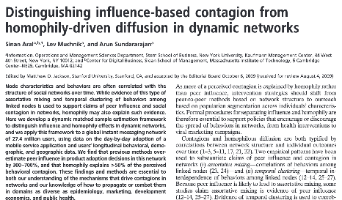
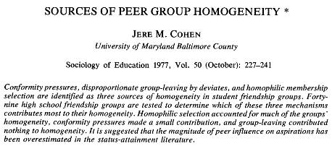
Interplay between Selection and Influence
Which effect is stronger: Selection or Influence?
In general, Selection >> Influence!

Slide 14
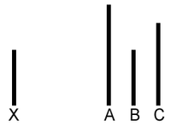
Solomon Asch’s Conformity Experiment
Yet, social influence remains very real!

Slide 15
Causally Separating Social Influence Effects
So far in the course, we’ve covered one way to make causal claims: Randomized Controlled Experiments
Now, we’ll cover two more methods for establishing causality:
Difference-in-Differences
Instrument Variable (IV) Regression

Slide 16
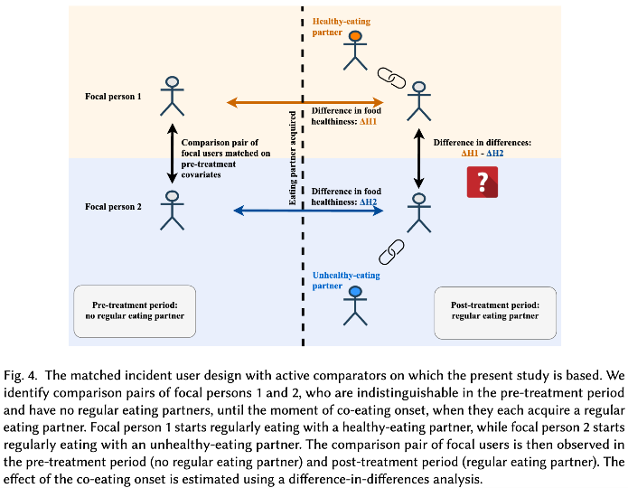
Notes:
where the food is purchased (what is the shop where the person most frequently buys food), when the food is purchased (what is the fraction of items occurring during lunchtime), what types of items are purchased (what fraction of purchased items are meals, and what is their estimated healthiness), and how often the person purchases food on campus (number of transactions). We measure these confounding covariates up to time 𝑡0

Slide 17
Instrument Variable (IV) Regression
Borrowed from Econometrics
Uses a 2-stage-least-squares (2SLS) approach to infer causality

Slide 18

Are exercise behaviors contagious?

Slide 19

Are exercise behaviors contagious?

Slide 20

Are exercise behaviors contagious?
Exercise behaviors are contagious if we can causally show that my friends’ exercise behaviors influenced me to change my exercise behavior

Slide 21
Are exercise behaviors contagious?
My friend runs
I run
Influence

Slide 22
Not so fast…
I befriend a runner
I WANT TO start running
Selection
But the opposite could also be true: maybe my friends didn’t cause my behavior change, rather I befriended people with the desired behavior in the first place

Slide 23
Not so fast…
Confounding variable
Apple watch introduces a cool feature
I run
My friend runs
Maybe a third party confounding variable is causing both me and my friend to demonstrate the exercise behavior. So, although there exists a social link between me and my friend, perhaps there is no social ‘contagion’ of behavior

Slide 24
Not so fast…
Apple watch introduces a cool feature
I run
My friend runs

Slide 25
Let’s take a detour: Are our soldiers paid fairly?
I go to the Vietnam war
My life earning suffers

Slide 26
Are our soldiers paid fairly?
Limited opportunities for growth
My life earning suffers
I go to the Vietnam war

Slide 27
Are our soldiers paid fairly?
Limited opportunities for growth
My life earning suffers
I go to the Vietnam war
All of these are Endogenous variables: Variables whose measures are internally determined by the model of the system

Slide 28
Introducing the Instrument Variable
Limited opportunities for growth
Draft lottery
My life earning suffers
I go to the Vietnam war
Endogenous variables

Slide 29
Introducing the Instrument Variable
Limited opportunities for growth
Draft lottery
My life earning suffers
I go to the Vietnam war
Endogenous variables

Slide 30
Introducing the Instrument Variable
Limited opportunities for growth
Draft lottery
My life earning suffers
I go to the Vietnam war
“Instrument variable”: An Exogenous variable!
Endogenous variables
An exogenous variable is one whose measure is determined outside the model and is imposed on the model
Notes:
In an economic model, an exogenous variable is one whose measure is determined outside the model and is imposed on the model, and an exogenous change is a change in an exogenous variable

Slide 31
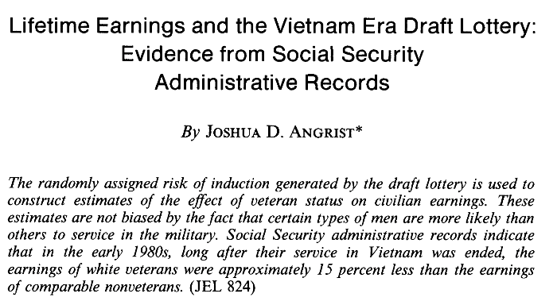

Slide 32
Reminder to self: Attendance

Slide 33
Readings for today’s class: Chapter 7, 8

Slide 34
Social Influence: Behavior Contagion

Slide 35
Potential Choices of an Instrument Variable
Policy changes
Weather events
Natural disasters

Slide 36
Another Example: Does Smoking CAUSE poor health?
Smoking
Poor health

Slide 37
Does Smoking CAUSE poor health?
Depression
Poor health
Smoking

Slide 38
Does Smoking CAUSE poor health?
Depression
Poor health
Smoking

Slide 39
Does Smoking CAUSE poor health?
Depression
?
Poor health
Smoking
Endogenous variables

Slide 40
Does Smoking CAUSE poor health?
Depression
Tobacco tax
Poor health
Smoking
“Instrument variable”: Exogenous variable!
Endogenous variables

Slide 41
Returning to the Original Question: Are exercise behaviors contagious?
Apple watch introduces a cool feature
I run
My friend runs

Slide 42
Are exercise behaviors contagious?
Apple watch introduces a cool feature
?
I run
My friend runs

Slide 43
Are exercise behaviors contagious?
Apple watch introduces a cool feature
Weather at my friend’s location
I run
My friend runs
Aral, Sinan, and Christos Nicolaides. "Exercise contagion in a global social network." Nature Communications 8.1 (2017): 14753.

Slide 44
Use Weather as an Instrument
Apple watch introduces a cool feature
Weather at my friend’s location
I run
My friend runs
Aral, Sinan, and Christos Nicolaides. "Exercise contagion in a global social network." Nature Communications 8.1 (2017): 14753.

Slide 45
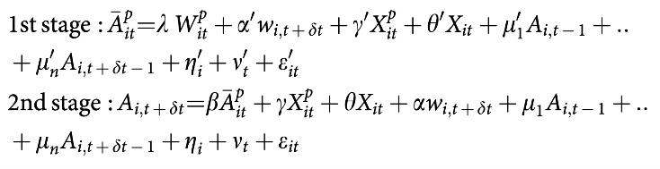
Weather at friend’s location

Slide 46
Friend’s predicted activity level
Weather at friend’s location

Slide 47
Friend’s predicted activity level
Weather at friend’s location
Friend’s predicted activity level

Slide 48
Friend’s predicted activity level
Weather at friend’s location
Friend’s predicted activity level
My activity level

Slide 49
This β now holds estimates of social influence in a causal manner. If β is positive and significant, my friends’ activities causally influence me in the positive direction (more activity from friends → more activity from me). If negative, then an increase in friends’ activities will cause me to reduce my own activities.

Slide 50
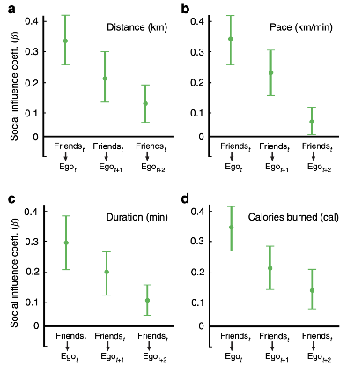
β is positive and significant here: my friends’ activities on day t causally influence me in the positive direction on days t, t+1, t+2 (more activity from friends → more activity from me). In other words, the effects persist on the same day, the day after, and the second day after!
Aral, Sinan, and Christos Nicolaides. "Exercise contagion in a global social network." Nature Communications 8.1 (2017): 14753.

Slide 51
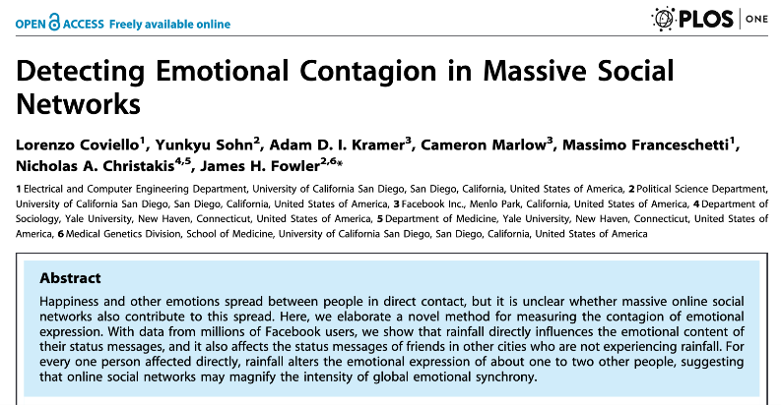
Are emotions contagious?

Slide 52
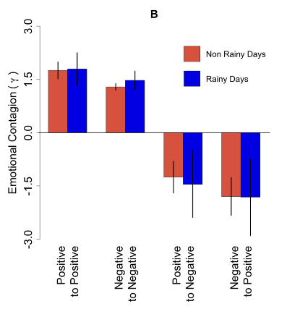
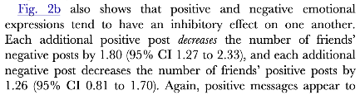
Use Weather as an Instrument

Slide 53
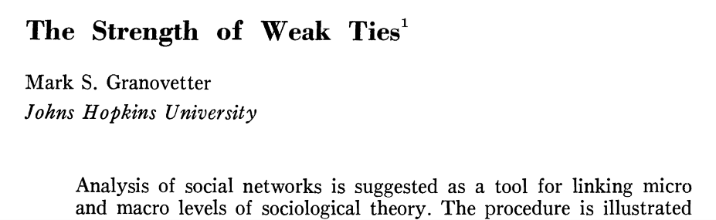

Slide 54

How do you test the idea?
Traditional approach: Ask around!
: Hey, how did you learn about this job?
: Bob told me.
: Would you say Bob is a close friend or an acquaintance?
: I’d say acquaintance.

Slide 55

Now we have LinkedIn!

Slide 56

Now we have LinkedIn!

Slide 57
Now we have LinkedIn!
4 mutual friends
Tie strength can be measured!

Slide 58
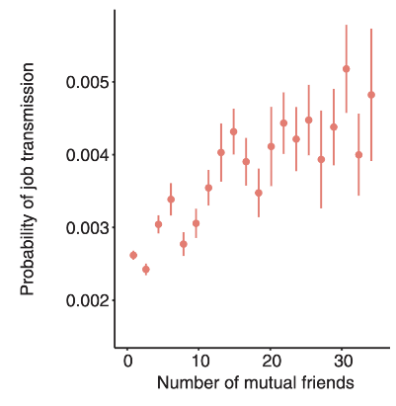
Now we have LinkedIn!
4 mutual friends

Slide 59
Now we have LinkedIn!
4 mutual friends
Strong ties appear to work better!

Slide 60
Not so fast…
My ‘weak tie’ friend works at Google
I join Google

Slide 61
Not so fast…
I form a tie with a Google engineer
I WANT TO JOIN Google

Slide 62
Not so fast…
Job market situation changes
My ‘weak tie’ friend works at Google
I join Google

Slide 63
Not so fast…
Job market situation changes
My ‘weak tie’ friend works at Google
I join Google
LinkedIn kept recommending us Google opportunities

Slide 64
Use Recommendation Engine Updates as an Instrument
Job market situation changes
Peer recommendation engine updates
My ‘weak tie’ friend works at Google
I join Google
LinkedIn kept recommending me Google opportunities
Rajkumar, Karthik, et al. "A causal test of the strength of weak ties." Science 377.6612 (2022): 1304-1310.

Slide 65
Use Recommendation Engine Updates as an Instrument
Job market situation changes
Peer recommendation engine updates
My ‘weak tie’ friend works at Google
I join Google
LinkedIn kept recommending me Google opportunities
Rajkumar, Karthik, et al. "A causal test of the strength of weak ties." Science 377.6612 (2022): 1304-1310.

Slide 66
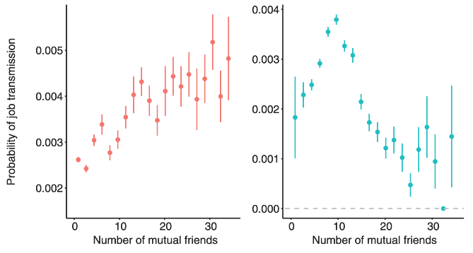
OLS
IV Regression
Rajkumar, Karthik, et al. "A causal test of the strength of weak ties." Science 377.6612 (2022): 1304-1310.

Slide 67
OLS
IV Regression
The strength of weak ties!
Rajkumar, Karthik, et al. "A causal test of the strength of weak ties." Science 377.6612 (2022): 1304-1310.

Slide 68
Social Influence: Information Diffusion
Notes:
Implicit, explicit
Linear threshold
Intelligence story
Katz influencer
Spread of true and false
Early detection

Slide 69
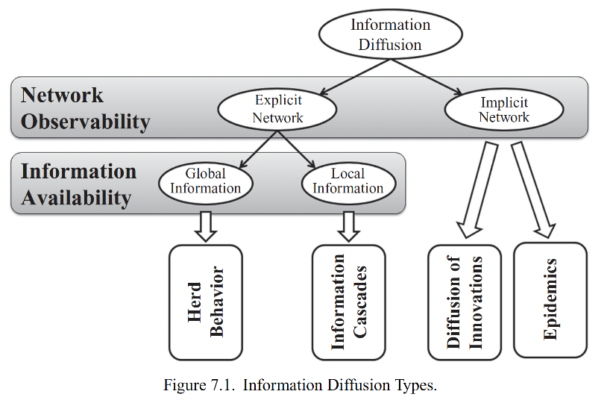

Slide 70
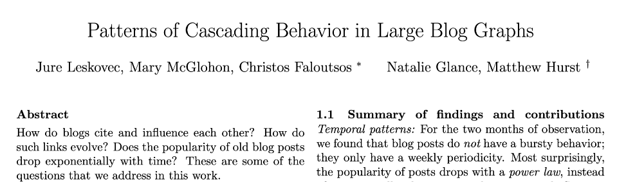
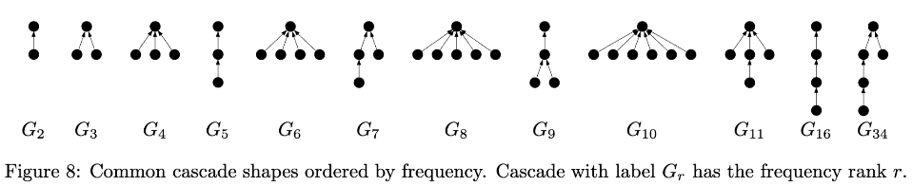

Slide 71
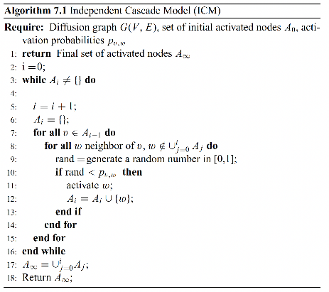
Independent Cascade Model

Slide 72
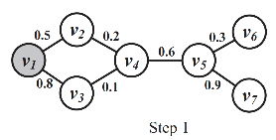

Slide 73
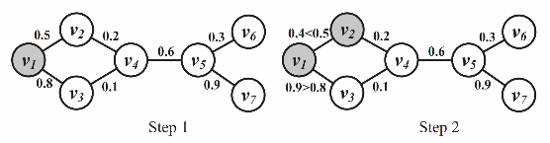

Slide 74
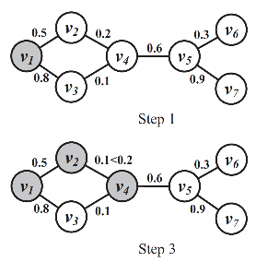

Slide 75
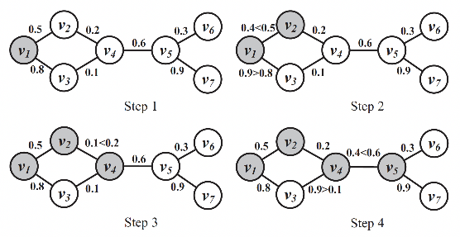

Slide 76
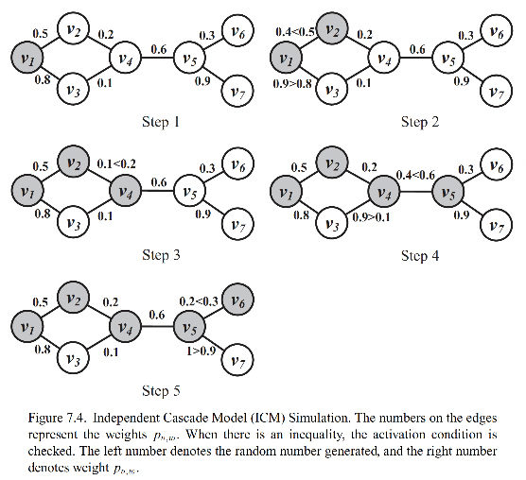

Slide 77
‘Network’ Interventions for Maximizing the Spread of Cascades
Increase the number of out-links of the sender node
Increase the number of in-links of receiver nodes
Increase the activation probability of a node (p_{v,w})

Slide 78
‘Network’ Interventions for Minimizing the Spread of Cascades
Limit the number of out-links of the sender node
Limit the number of in-links of receiver nodes
Decreasing the activation probability of a node (p_{v,w})
Looking at only the network elements using this model, it appears that tuning these three parameters is all we need for designing a successful intervention. But we must consider the human elements working on top of the network elements, since all of these parameters are determined by socio-psychological factors and effects

Slide 79
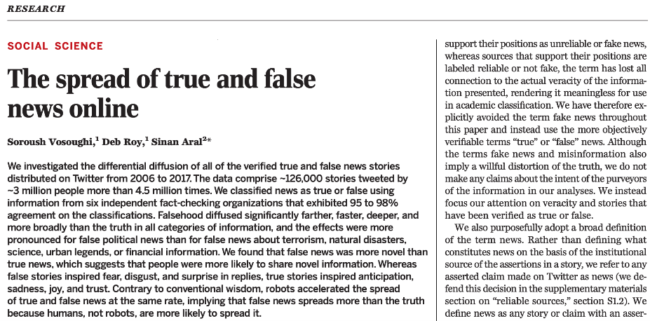

Slide 80
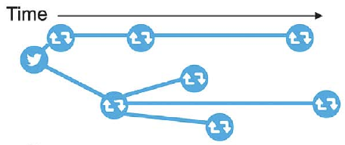
Twitter data: 2006 to 2017
~126,000 rumor cascades
Fact checked
Spread by ~3 million people

Slide 81
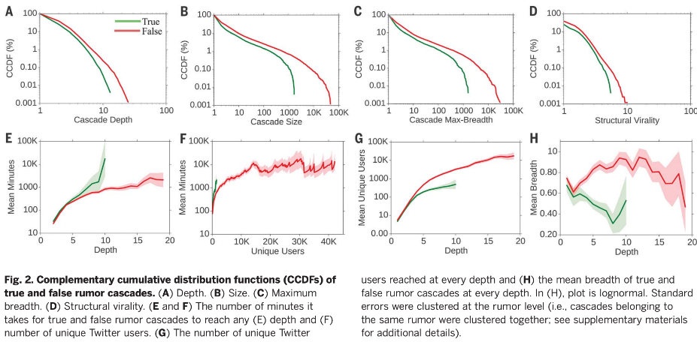
The number of retweet hops from the origin tweet over time, where a hop is a retweet by a new unique user

Slide 82
The number of users
involved in the cascade over time

Slide 83
The maximum number of users involved
in the cascade at any depth

Slide 84
Falsehood diffuses significantly farther, faster, deeper, and more broadly than the truth in all categories of information

Slide 85
The ‘Human’ Element in Information Diffusion
False news is more novel than true news
People are more likely to share novel information
False stories inspire fear, disgust, and surprise in replies
True stories inspired anticipation, sadness, joy, and trust
False news spreads more than the truth because humans, not robots, are more likely to spread it

Slide 86
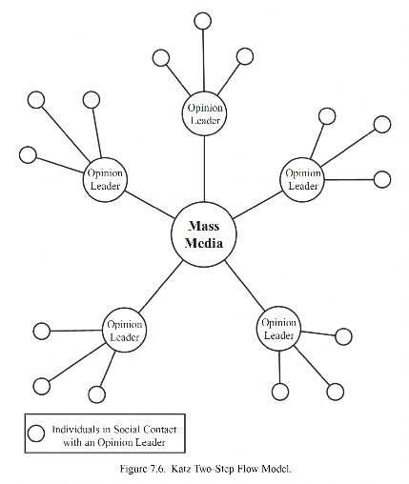
If the opinion leaders have both the network and human elements we discussed, they will be more successful in diffusing information

Slide 87
Influence and
Influencers
Simple measurements of influence on Twitter
In-degree (e.g., # of followers)
Other centrality measures
Number of mentions
Number of Retweets

Slide 88
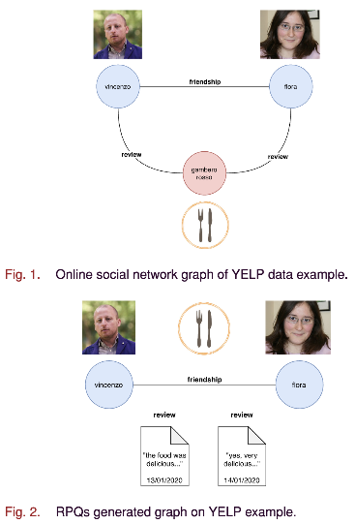
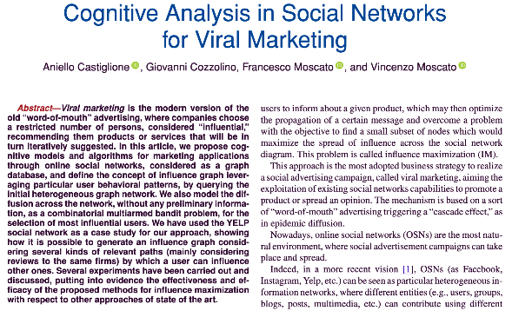

Slide 89
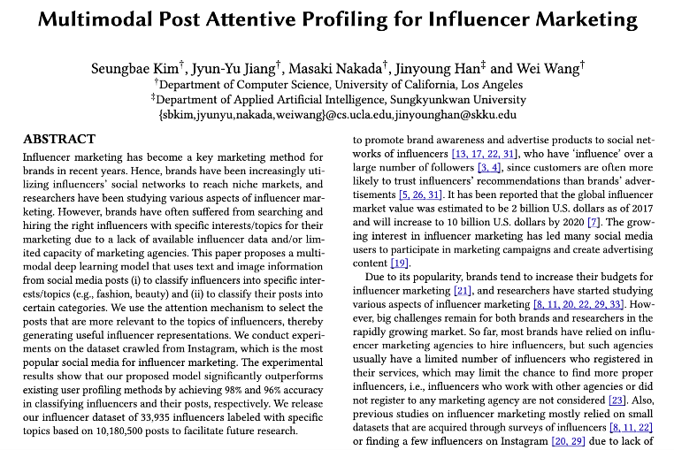

Slide 90
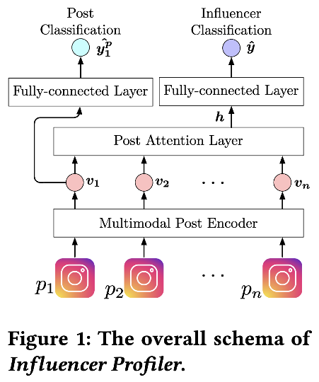

Slide 91
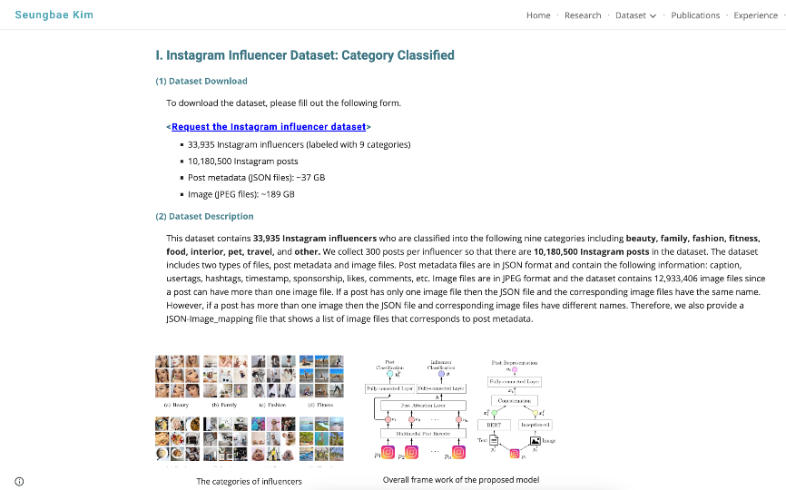

Slide 92
References
Chapter 8 of the textbook
Networks, Crowds, and Markets, David Easley and Jon Kleinberg
Networks: An Introduction, MEJ Newman
Statistical Analysis of Networked Data: Methods and Models, Erik D. Kolaczyk

Slide 93
Summary

